Slide 1
Linear Control Systems (LCS)
Steady State Error

Slide 2
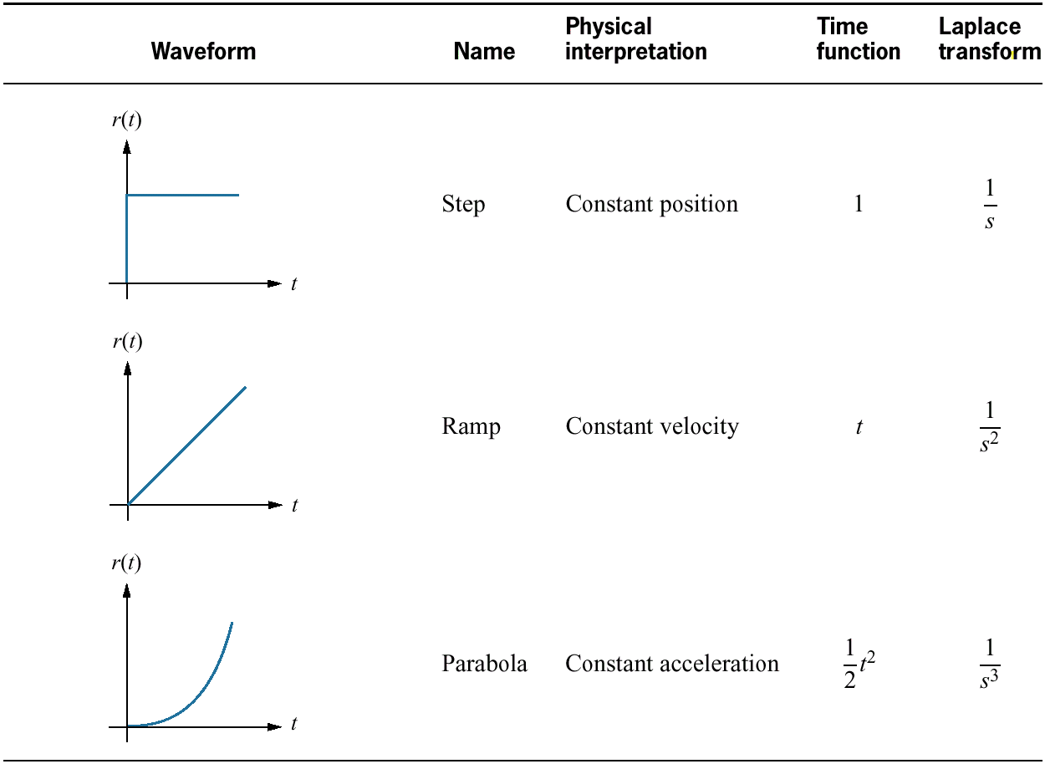
Test waveforms for evaluating steady-state errors of position control systems
Chapter 7: Steady state error analysis

Slide 3
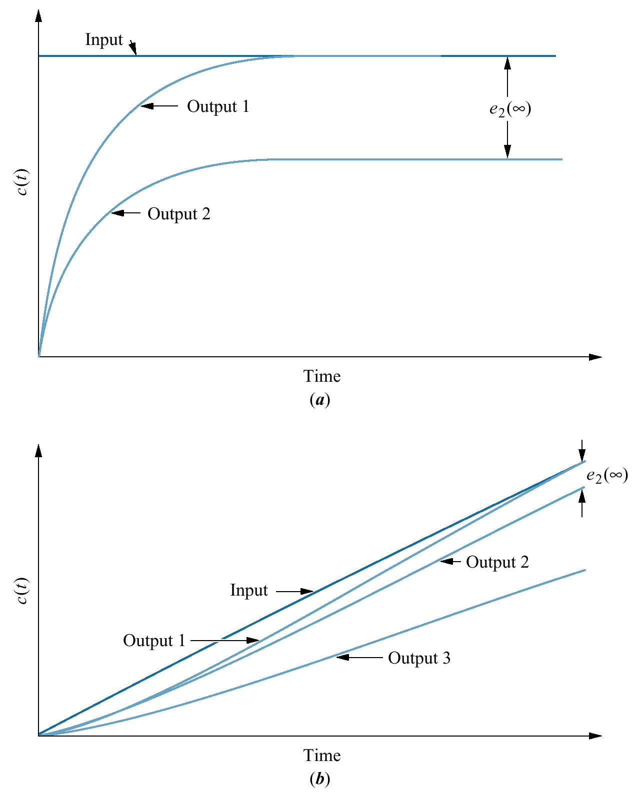
Steady-state error: a. step input; b. ramp input
System response to different inputs

Slide 4
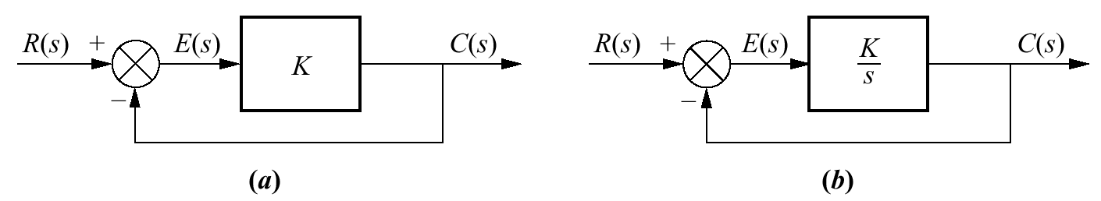
System with: a. finite steady-state error for a step input; b. zero steady-state error for step input
Intuition/motivation for steady state error analysis
E_{steady state}=(1/K)C_{steady state}
E_{steady state}=0 for C_{steady state}≠ 0

Slide 5
Introduction
Any physical control system inherently suffers steady-state error in response to certain types of inputs.
A system may have no steady-state error to a step input, but the same system may exhibit nonzero steady-state error to a ramp input.
Whether a given system will exhibit steady-state error for a given type of input depends on the type of open-loop transfer function of the system.

Slide 6
Classification of Control Systems
Control systems may be classified according to their ability to follow step inputs, ramp inputs, parabolic inputs, and so on.
The magnitudes of the steady-state errors due to these individual inputs are indicative of the goodness of the system.

Slide 7
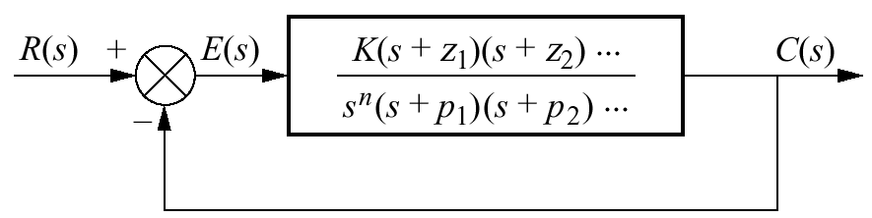
Figure 7.8 Feedback control system for defining system type

Slide 8
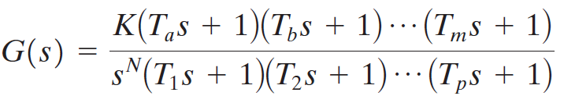
Classification of Control Systems
Consider the unity-feedback control system with the following open-loop transfer function
It involves the term s^{N} in the denominator, representing N poles at the origin.
A system is called type 0, type 1, type 2, ... , if N=0, N=1, N=2, ... , respectively.

Slide 9
Classification of Control Systems
As the type number is increased, accuracy is improved.
However, increasing the type number aggravates the stability problem.
A compromise between steady-state accuracy and relative stability is always necessary.

Slide 10
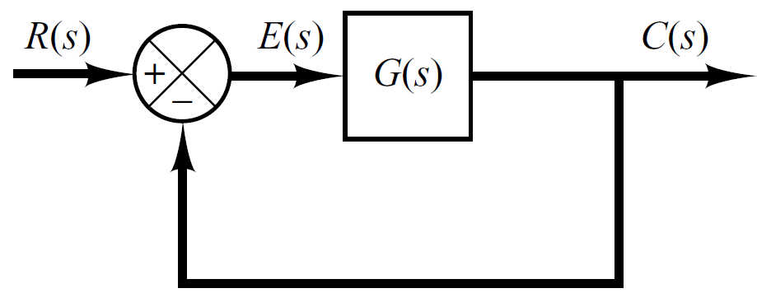

Steady State Error of Unity Feedback Systems
Consider the system shown in following figure.
The closed-loop transfer function is

Slide 11

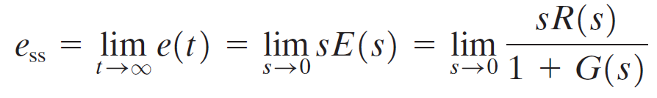
Steady State Error of Unity Feedback Systems
The transfer function between the error signal E(s) and the input signal R(s) is
The final-value theorem provides a convenient way to find the steady-state performance of a stable system.
Since E(s) is
The steady state error is

Slide 12
Static Error Constants
The static error constants are figures of merit of control systems. The higher the constants, the smaller the steady-state error.
In a given system, the output may be the position, velocity, pressure, temperature, or the like.
Therefore, in what follows, we shall call the output “position,” the rate of change of the output “velocity,” and so on.
This means that in a temperature control system “position” represents the output temperature, “velocity” represents the rate of change of the output temperature, and so on.

Slide 13
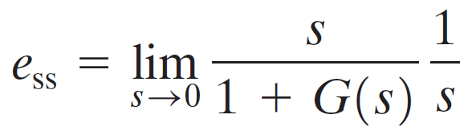
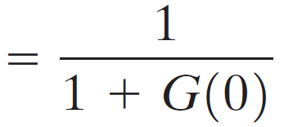
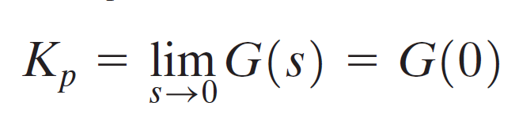
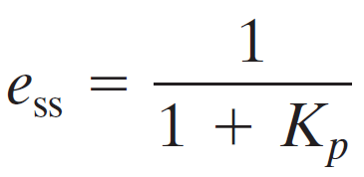
Static Position Error Constant (K_{p})
The steady-state error of the system for a unit-step input is
The static position error constant K_{p} is defined by
Thus, the steady-state error in terms of the static position error constant K_{p} is given by

Slide 14
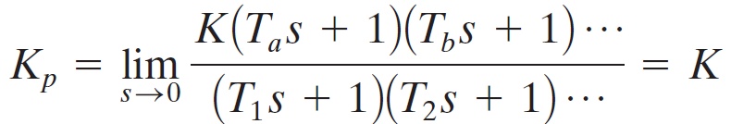
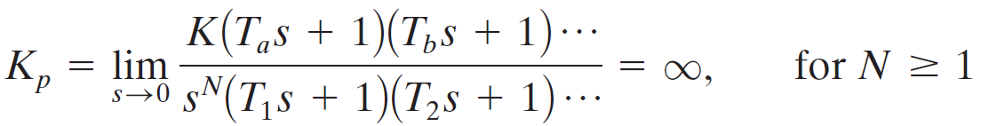
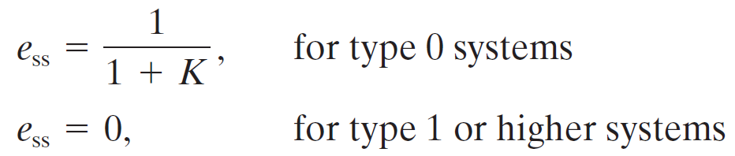
Static Position Error Constant (K_{p})
For a Type 0 system
For Type 1 or higher systems
For a unit step input the steady state error e_{ss} is

Slide 15
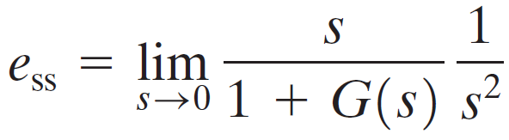
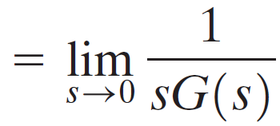

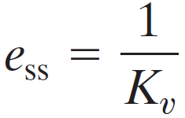
Static Velocity Error Constant (K_{v})
The steady-state error of the system for a unit-ramp input is
The static position error constant K_{v} is defined by
Thus, the steady-state error in terms of the static velocity error constant K_{v} is given by

Slide 16
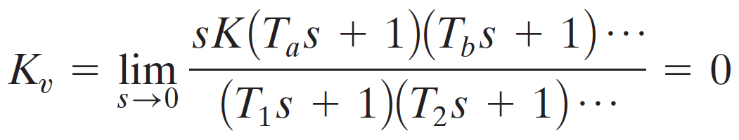
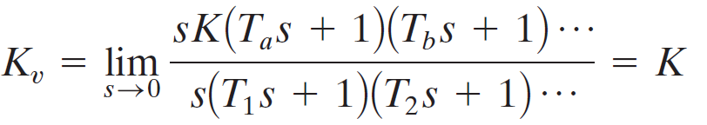
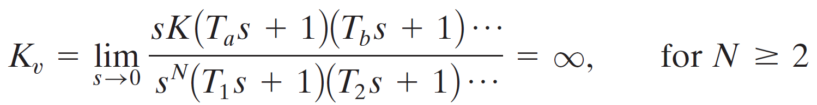
Static Velocity Error Constant (K_{v})
For a Type 0 system
For Type 1 systems
For type 2 or higher systems

Slide 17
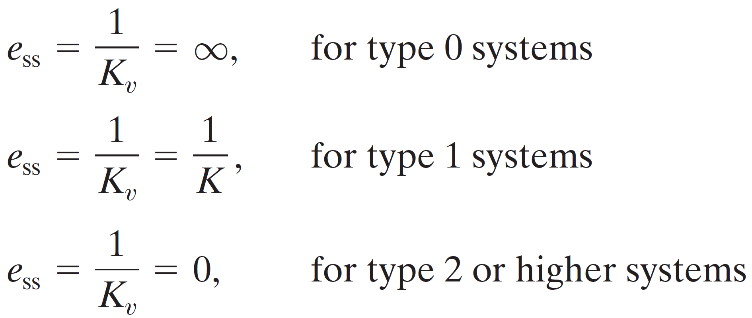
Static Velocity Error Constant (K_{v})
For a ramp input the steady state error e_{ss} is

Slide 18
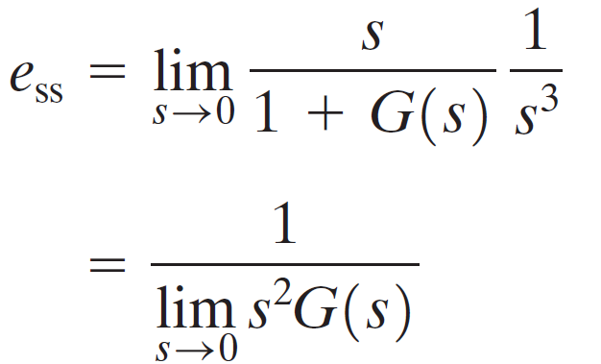
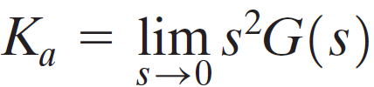
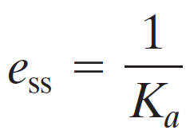
Static Acceleration Error Constant (K_{a})
The steady-state error of the system for parabolic input is
The static acceleration error constant K_{a} is defined by
Thus, the steady-state error in terms of the static acceleration error constant K_{a} is given by

Slide 19

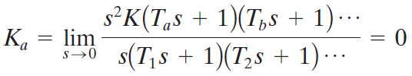
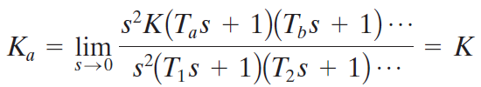
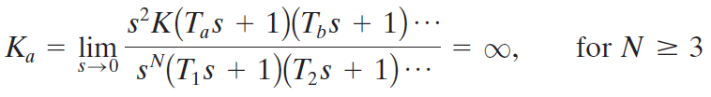
Static Acceleration Error Constant (K_{a})
For a Type 0 system
For Type 1 systems
For type 2 systems
For type 3 or higher systems

Slide 20
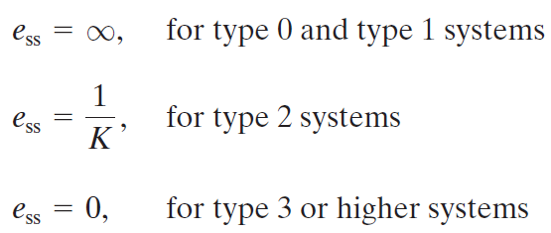
Static Acceleration Error Constant (K_{a})
For a parabolic input the steady state error e_{ss} is

Slide 21
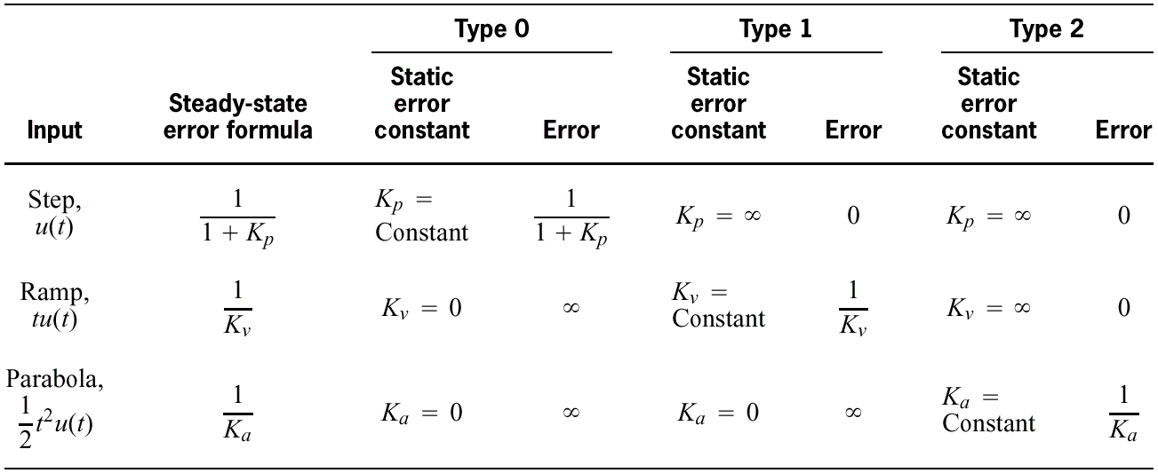
Table 7.2 Relationships between input, system type, static error constants, and steady-state errors

Slide 22
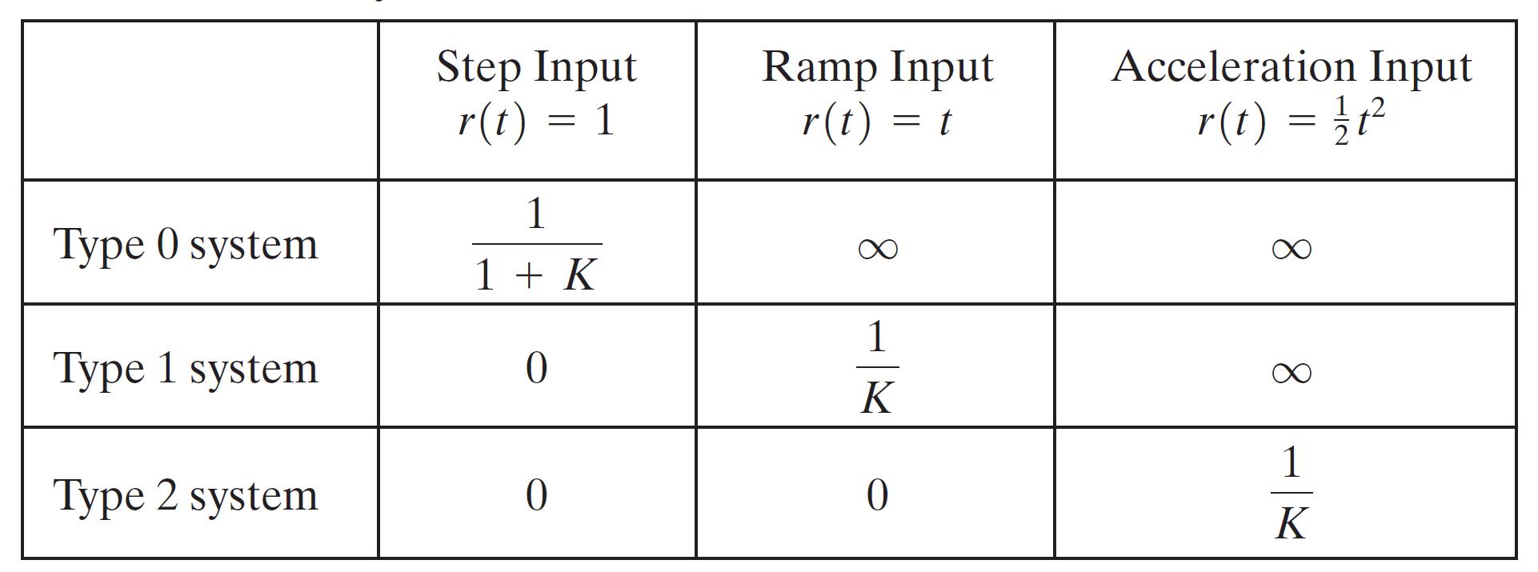
Summary

Slide 23
Example#1
For the system shown in figure below evaluate the static error constants and find the expected steady state errors for the standard step, ramp and parabolic inputs.
R(S)
C(S)
-

Slide 24
Example#1 (evaluation of Static Error Constants)

Slide 25
Example#1 (Steady Sate Errors)

